Slide 1
Introduction To React
By Prof. Soleha . A . Sayyed

Slide 2
Evolution of Front-end Frameworks:
The evolution of frontend frameworks witnesses Angular and React emerge as widely popular JS frameworks utilized by Software Professionals globally.
They are instrumental in creating rich content and interactive web applications, particularly focusing on frontend development, shaping what users see and visualize.
For example, giants like Facebook, Amazon, and Google have already been widely using these frameworks to increase their popularity.
Explore the evolution of frontend frameworks with these versatile tools.
React, which gave developers the flexibility to build applications using a centralized immutable state approach (all of the data in the application is in one place, remaining unchanged as opposed to MVC), such as Redux, whilst having the freedom to use any other libraries alongside this lightweight, but powerful centerpiece of the application.
Facebook then became a major contributor to the Front-End Developer community.

Slide 3
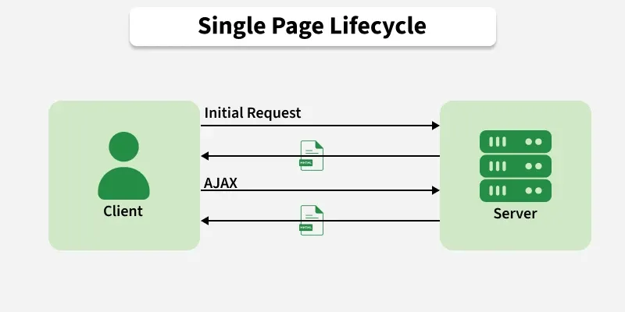
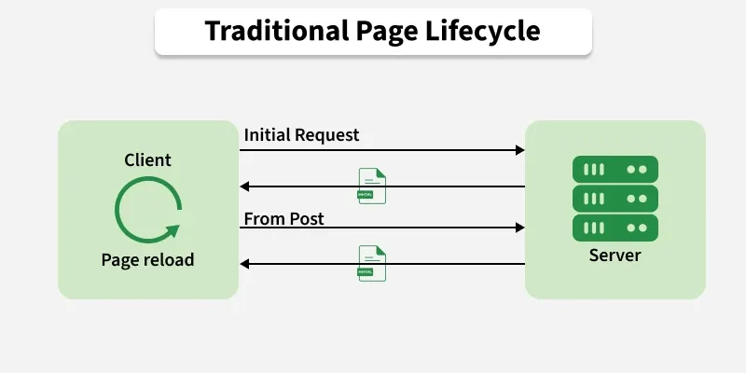
Single Page Application
A Single Page Application (SPA) is a web app that loads content dynamically without refreshing the whole page.
It uses JavaScript to update only the required parts of the screen based on user actions.
This creates a smooth, fast, and app-like user experience.
Eliminates full page reloads for better performance
Sends and updates only the necessary data from the server
Provides a more responsive and seamless interface

Slide 4
Scenarios to Use SPA
Dynamic Interactions: Choose SPAs for applications requiring frequent user interactions without full page reloads.
Real-Time Updates: To decide for SPAs when real-time responsiveness is crucial for a seamless user experience.
Mobile-Friendly: Use SPAs for mobile-friendly apps, providing an app-like feel with smooth transitions.
Rich User Interfaces: Consider SPAs for interactive interfaces with features like animations and dynamic content.
Minimized Server Load: Utilize SPAs when reducing server load and bandwidth usage is a priority.
Single-Page Content: Prefer SPAs for content logically presented on a single page, avoiding the need for multiple pages.
Cross-Platform Consistency: Choose SPAs for maintaining a consistent user experience across various devices and platforms.

Slide 5
SPA Architecture and its Working
A Single Page Application (SPA) loads once and then updates content without reloading the page, giving a fast and smooth user experience.
It includes three renderings :
1. Client-side rendering
First, the browser requests HTML from the server.
Then the server swiftly responds with a basic HTML file and linked styles/scripts.
Now the user sees a blank page or loader while JavaScript executes.
App fetches data, creates views, and injects them into the DOM.
Client-Side Rendering (CSR) can be slower for basic websites because it uses a lot of device resources.
Yet, it's good for busy websites, making things faster for users. Just remember, if you want different social sharing options, you might need Server-Side Rendering (SSR) or Static Site Generation (SSG) instead.

Slide 6
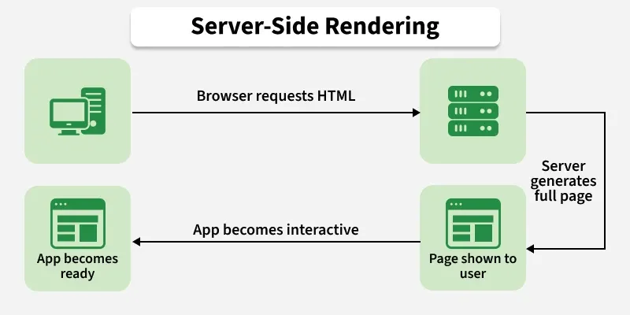
2. Server-side rendering (SSR)
The browser first asks the server for an HTML file.
Now the server gathers necessary data, builds the SPA, and creates an HTML file instantly.
Now the user sees the content ready to go.
Single-page app structure adds events, makes a virtual DOM, and gets things ready.
Now, the application is set for use.
HUSPI opts for server-side rendering to achieve a swift application experience, balancing the speed of single-page applications without burdening the user's browser, ensuring optimal app performance.

Slide 7
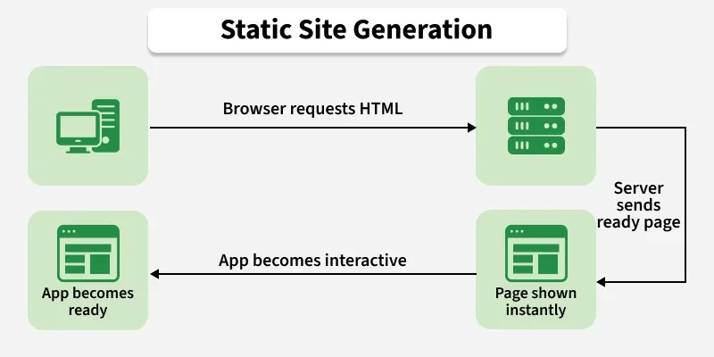
3. Static site generator (SSG)
Browsers ask for HTML; SSGs quickly provide pre-made static pages.
The server shows users the static page for fast loading.
SPAs in the page fetch data and make dynamic changes to the page.
SPA is ready for smooth user interaction after data is added.
SSGs are great for fast static pages but may not be ideal for highly dynamic websites.
While static site generators offer a quick and efficient solution, it's crucial to note that they might not be the perfect fit for websites with dynamic content. Their strength lies in static pages, aligning with their name.

Slide 8
Advantages of SPAs
Faster User Experience: SPAs load only once and update data as needed, which reduces page reloads and makes the application feel smooth and fast.
Offline Access with Caching: SPAs can store data in the browser, allowing users to access some features even without an internet connection.
Better Performance: Since only required data is loaded and updated, server requests are reduced, leading to faster load times.
Lower Bandwidth Usage: SPAs transfer only necessary data instead of reloading full pages, saving internet bandwidth.
Highly Responsive: Content updates happen instantly without refreshing the page, improving user interaction.
Smooth Navigation: Client-side routing allows users to move between sections without page reloads.
Works Across Devices: SPAs run smoothly on desktops, tablets, and mobile devices, ensuring a consistent experience.

Slide 9
Disadvantages of SPAs
Slower Initial Load: Can be slower initially, affecting users with slower internet.
SEO Challenges: SEO can be tricky due to heavy reliance on JavaScript.
Limited Browser Support: Advanced features may not work well on older browsers.
Security Risks: Vulnerable to security issues like Cross-Site Scripting (XSS).
Client-Side Resource Intensity: Places a heavy load on the client side, impacting older devices.

Slide 10
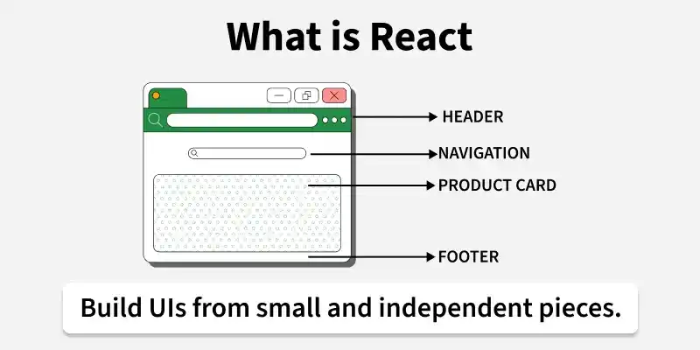
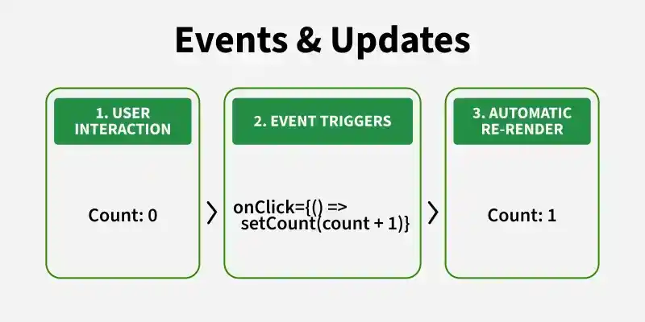
What is React?
ReactJS is a component-based JavaScript library used to build dynamic and interactive user interfaces.
It simplifies the creation of single-page applications (SPAs) with a focus on performance and maintainability.
Uses reusable components for better code organization.
Improves performance with a virtual DOM.
Supports unidirectional data flow for predictable behavior.
It is developed by Facebook.

Slide 11
First "Hello, World!" Program in React
import React from "react";
function App()
{
return (<div><h1>Hello, World!</h1>
</div>);
}
export default App;
In this code,
import React from 'react': Imports React to create components and use JSX.
function App() { ... }: Defines a functional component called App.
return ( ... ): Returns JSX that represents the UI (a div with an h1 tag displaying "Hello, World!").
export default App: Exports the App component so it can be used elsewhere.

Slide 12
Why use React JS?
The main reason why React is so popular is that it offers developers an easy way to create applications with a lot of functionality at once.
It means that the app doesn't need to be as complicated as other frameworks; instead, you can focus on building features in the app rather than how to get those features up and running on the web.
This can help make your app easier for users to understand and use! There are multiple platforms based on React to create web applications, mobile applications, and cross-hybrid platforms for desktops.
Another benefit of using React is that it doesn't require any knowledge of HTML or CSS before getting started with development.
You don't need any experience with either one before using React; all you need is an understanding of JavaScript syntax and how functions work within the language itself

Slide 13
Advantages of React:
Ease of Use: ReactJS does not require writing lengthy code as it supports the Components concept, so a small amount of code can be created and can be used in multiple places.
Faster to build: Because of its component-based approach and virtual DOM, React is a lot faster than other frameworks. This means that you won't have to spend much time developing your app or website.
Multiple Module Support: There are so many modules in ReactJS that can be used to make your development more scalable and manageable at a fast pace.
Multiple Apps Development: By using React knowledge, we can create Web Pages, Web Apps, Mobile Apps, and VR Apps. There are a lot of websites that are using ReactJS, like Airbnb, Cloudflare, Facebook, Instagram, etc.
Easy Migration: Because of its easy learning curve, migration from other technologies became so easy. There are tons of resources to learn ReactJS from the basics to advanced.
Large Community: ReactJS has one of the largest communities to help you when you are in trouble debugging your code or get stuck learning new things.

Slide 14
Applications of React:
Web Development: React is used to build dynamic and responsive web applications, including social media platforms, e-commerce sites, and blogs.
Mobile Apps: React Native allows developers to build mobile apps for iOS and Android using the same codebase.
Enterprise Applications: React is used in building large-scale enterprise applications that require a highly interactive UI.
Dashboards and Data Visualizations: React is great for building real-time dashboards and data visualization tools due to its high performance.
Advantages of React:
Easy To Learn
Faster To Build
Tons Of Applications in the Web Development Field
Creating Dynamic Web Pages
Efficient Code Reuse Facility
Testability of Apps

Slide 15
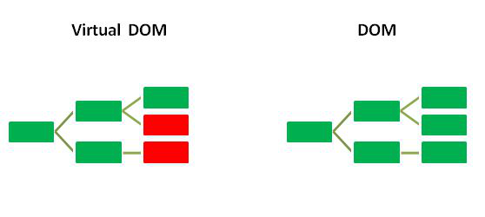
Features of React
1. JSX(JavaScript Syntax Extension)
JSX is a combination of HTML and JavaScript. You can embed JavaScript objects inside the HTML elements. JSX makes code easy and understandable. It is easy to learn if you know HTML and JavaScript.
const name=“Hello MCS";
const element = <h1>Welcome to {name}</h1>;
2. Virtual DOM
DOM (Document Object Model), unlike traditional approaches that update the entire DOM, React uses a Virtual DOM, which is a lightweight copy of the real DOM. When changes occur, React updates the Virtual DOM first, compares it with the real DOM, and updates only the modified parts, improving performance.

Slide 16
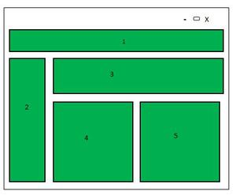
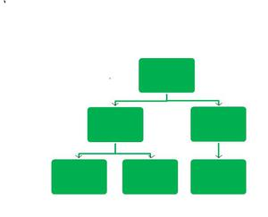
3. Component-based Architecture
React.js divides the web page into multiple components as it is component-based. Each component is a part of the UI design, which has its own logic and design, as shown in the image below. So the component logic which is written in JavaScript, makes it easy to run faster and can be reusable.
4. One-way Data Binding
React follows one-way data binding, where data flows from parent components to child components through props. This unidirectional flow makes data easier to manage and helps maintain predictable application behavior.

Slide 17
5. State Management
State is used to store and manage dynamic data within a component. When the state changes, React automatically updates the affected parts of the user interface without reloading the page.
import { useState } from "react";
function Counter() {
const [count, setCount] = useState(0);
return (
<button onClick={() => setCount(count + 1)}>
Count: {count}
</button>
);
}
6. High Performance
As we discussed earlier, React uses virtual DOM and updates only the modified parts. So, this makes the DOM run faster. DOM executes in memory, so we can create separate components, which makes the DOM run faster.

Slide 18
7. React Hooks
Hooks are built-in functions that allow functional components to use features such as state and lifecycle management. Commonly used hooks include useState, useEffect, and useContext.
import { useEffect } from "react";
function Example() {
useEffect(() => {
console.log("Component Mounted");
}, []);
return <h2>Hello React</h2>;
}
8. Extensibility
React has many extensions that we can use to create full-fledged UI applications. It supports mobile app development and provides server-side rendering. React is extended with Flux, Redux, React Native, etc., which helps us to create a good-looking UI.

Slide 19
Workflow of React JS:
The workflow of React.js revolves around a component-based architecture and a unidirectional data flow. Here is a breakdown of the typical workflow:
Project Initialization: The React project is initialized using tools like Create React App.
npx: Node package editor npm: Node Package Manager
npx create-react-app my-app (file name) cd my-app npm start
2. Component Structure:
The UI is broken down into reusable components. Each component represents a part of the interface and is usually written using JSX (JavaScript XML).
3. JSX and Rendering:
React components use JSX to define what the UI should look like. These components are rendered to the DOM using the ReactDOM.render() method.
4. State and Props Management:
Props are used to pass data from parent to child components. State is used to manage dynamic data within a component, often handled using React Hooks like useState and useEffect.

Slide 20
5. Event Handling:
React allows handling user interactions through events such as clicks, form submissions, etc., using inline or callback functions.
6. Routing:
For multi-page applications, React uses libraries like React Router to navigate between components (pages) without reloading the page.
7. Side Effects and Data Fetching:
The useEffect hook is commonly used for performing side effects such as fetching data from an API or interacting with the browser DOM.
8. Styling:
Components can be styled using CSS, CSS Modules, styled-components, or utility-first frameworks like Tailwind CSS.
9. Build and Deployment:
After development, the app is built using npm run build, creating optimized static files ready for deployment to platforms like Vercel, Netlify, or GitHub Pages.

Slide 21
Scope of React JS:
Single-Page Applications (SPAs): React is widely used to develop fast and responsive single-page applications.
Web Applications: Used to build dynamic and responsive Single Page Applications.
Mobile Applications: Through React Native, React can be used to develop cross-platform mobile apps for iOS and Android.
Static Site Generation & SSR: With frameworks like Next.js and Gatsby, React supports server-side rendering and static site generation.
Enterprise Solutions: Many large-scale applications and dashboards are built using React due to its scalability and performance.
Career Opportunities: React developers are in high demand globally, with React often listed as a top skill in job postings.
E-commerce Websites: React is extensively used to build e-commerce platforms that require real-time updates, smooth user experiences, and efficient state management.
High Career Demand: React developers are in strong demand across industries, providing excellent career opportunities in front-end and full-stack web development.

Slide 22
Difference between React 15 vs React 16:
React 15 | React 16
Based on the older stack algorithm | Introduced a new Fiber architecture more efficient and flexible
Errors in components could crash the entire app | Introduced Error Boundaries to catch rendering errors locally
render() had to return a single DOM node | render() can return arrays and fragments (<> </>)
Portals are not available | Introduced React Portals for rendering components outside the main DOM tree
Less efficient rendering and updates | Faster, more interruptible rendering using Fiber
Concurrent mode Not available | Fiber enabled foundation for Concurrent Mode

Slide 23
Virtual DOM and real DOM
Real DOM
The Document Object Model (DOM) is a programming interface for web documents.
It represents the HTML structure of a web page, which can be accessed and manipulated by JavaScript.
When a web page is loaded, the browser creates a DOM tree that consists of all the HTML elements on the page.
Through the use of JavaScript, the DOM tree can be modified to update the web page.
For instance, if you wish to change the text content of a button on a web page, you can select the button element using JavaScript and update its text content through the DOM.

Slide 24
Virtual DOM
The Virtual DOM is a crucial concept utilized in modern frameworks such as React, which significantly improves the performance of updating the real DOM.
When a state change occurs in a React component, instead of updating the actual DOM directly, React creates a lightweight replica of the DOM known as the Virtual DOM.
React then compares the updated Virtual DOM with the previous one to identify the changes that need to be applied to the real DOM.
Once the changes are determined, React updates the real DOM in an optimized and efficient manner, thereby reducing unnecessary re-renders and improving overall performance.

Slide 25
Difference between Virtual and Real DOM
Real DOM | Virtual DOM
It represents a simplified version of a webpage’s underlying HTML code. | It serves as a simplified representation of the HTML Document Object Model (DOM).
It has the ability to manipulate elements displayed on the screen. | It lacks the ability to manipulate elements displayed on the screen.
Any modification results in the entire DOM tree being updated. | Any modification only updates the relevant node in the tree.
Updating proves to be a slow and inefficient process.Updating is slow and inefficient. | The process of updating is speedy and efficient.

Slide 26
Setting up a development environment: Create-react-app
A new React app can be created using the npx create-react-app command, which provides a fast and simple way to set up a React project.
Step 1: Install Node.js and NPM
The first step is to install Node.js and NPM in your system to create a React application.
Step 2: Initialize the React App Using create-react-app
If you have installed an npm version greater than or equal to 5.6, you can use the following npx command to create a new React app:
npx create-react-app app_name
If you are using npm version 5.1 or less, you cannot use the npx command; you need to install create-react-app globally by using the command
npm install -g create-react-app
create-react-app app_name
Step 3: Switch to the project directory
Once the project is created, switch to the project directory using the following command:
cd app_name

Slide 27
Step 4: Start the development server
To run the app, use the following command. This command will locally run your app.
npm start
Modify the React application by making a few changes in the App.js file.
// Filename - App.js
import React from 'react';
function App() {
const headingStyle = {
color: 'green',
textAlign: 'center'
};
return <h1 style={headingStyle}>Welcome to MCS-I</h1>;
}
export default App;
Output: Welcome to MCS-I

Slide 28
Vite
Vite is a fast and modern build tool for creating web applications. It increases the development process by providing faster build times and better performance.
Some of the benefits of using React with Vite are as follows:
Fast updates without page reloads.
Faster and smaller production builds.
Automatic JSX handling.
Faster Build
Steps to set up ReactJS with Vite
Step 1: Install Node.js
To install Node.js and npm, visit the Node.js official website and download the latest stable version.

Slide 29
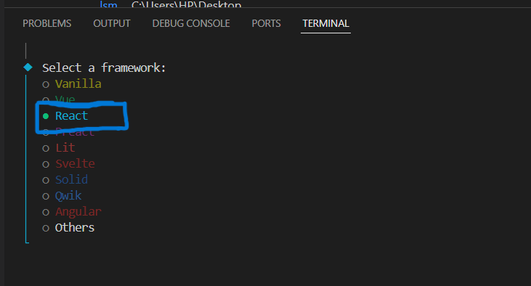
Step 2: Create a New Project with Vite
Vite provides a simple way to create new projects. You can use the following command to create a new React project with Vite.
npm create vite@latest my-react-app
cd my-react-app
Step 3: Select a Framework
Select the React framework.

Slide 30
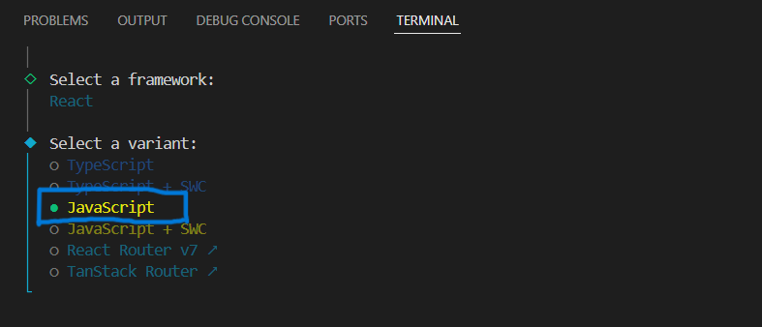
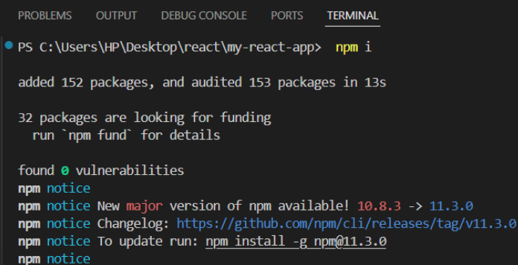
Step 4: Select Variant
Choose any variant according to your project requirements.
Step 5: Install Dependencies
After initializing the project, you need to install the necessary dependencies. This command will install all the required dependencies listed in the package.json file.
npm install

Slide 31
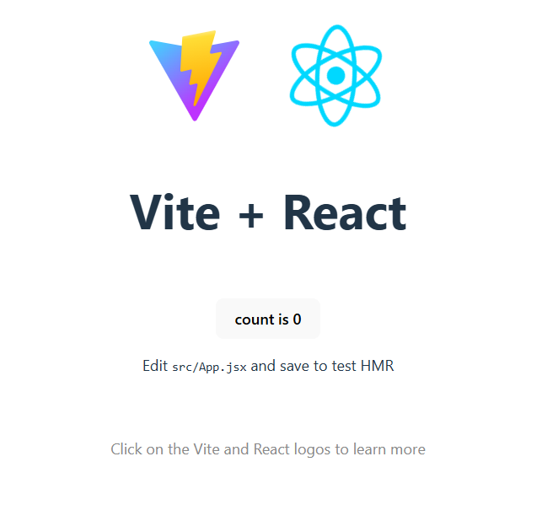
Step 6: Start the Server
To start the server, run the following command:
npm run dev

Slide 32
Running the React app:
If you already have a React folder, follow the steps below:
1. Open your terminal or command prompt
2. Navigate into the project's root folder using the cd command
cd name-of-your-project-folder
3. Install dependencies
npm install
4. Start the local server by running the appropriate command for your build system
npm start
5. Open your browser

Slide 33
Difference between Vite and create-react-app:
Vite | Create-react-app
The release year of Vite is 2020 | The release year of create-react-app is 2016
The development server of Vite is very faster | The development server of create-react-app is slower
It uses ES Modules and Rollup as building tool | It uses Webpack as building tool
The command is npm create vite@latest | The command is npx create-react-app my-app
It starts almost instantly | It takes more time to start
The speed is faster | The speed is slower
Built-in Tool | Requires additional setup
Modern React projects | Older or legacy React projects

Slide 34
Debugging the first React app:
Use the Browser Console: Open Developer Tools in your browser (usually with F12 or Ctrl+Shift+I). Check the Console tab for any error messages or warnings. These messages often include file names and line numbers to help you locate the issue.
Enable Source Maps: React apps (especially those created with Create React App) include source maps by default, which help you trace errors to the source files.
Use console.log(): Add console.log() statements to print variable values or check if a function is being called:
console.log("Component loaded");
console.log("User data:", user);
4. React Developer Tools: Install the React Developer Tools browser extension for Chrome or Firefox.It allows you to inspect the component tree, check props and state, and debug performance issues.

Slide 35
How to create package.json and purpose of it?
Method 1: Automatically (Preferred)
1. Open your terminal/command prompt.
2. Navigate to your project folder:
cd my-project
3. Run:
npm init
4. To skip the questions and create with defaults:
npm init -y
Method 2: Manually
1. Create a file called package.json
2. Add basic structure:
{
"name": "my-app",
"version": "1.0.0",
"description": "My first project",
"main": "index.js",
"scripts": {
"start": "node index.js"
},
"dependencies": {},
"author": "Your Name",
"license": "ISC"
}

Slide 36
Purpose of package.json:
1. Dependency Management:
It lists all the project's dependencies (external libraries and packages) and their versions. npm and yarn use this information to install the correct versions when a project is set up or updated.
2. Project Metadata:
It stores information like the project's name, version, description, author, license, and repository location, providing essential details about the project.
3. Script Automation:
It allows you to define custom scripts for common tasks like testing, building, or deployment, enabling automation and standardization.
4. Version Control:
Specifying version ranges for dependencies, it helps maintain consistency across different environments and prevents issues caused by using different versions of packages.
5. Ecosystem Integration:
It's used by various tools and platforms (like CI/CD services, cloud platforms, etc.) to understand and interact with the project.

Slide 37
5. Check Component Props and State: Incorrect or missing props and unexpected state changes often cause bugs.Use console.log() or React Developer Tools to verify their values.
6. Use Error Boundaries (Optional)
For more advanced apps, consider using Error Boundaries to gracefully handle runtime errors in components.
7. Watch for Common Issues
Unclosed tags in JSX.
Forgetting to import a component or hook.
Incorrect use of hooks (e.g., calling a hook inside a loop or condition).
State not updating immediately due to React's async rendering.

Slide 38
Anatomy of React Project:
public/ Folder
Contains static assets and the main HTML file.
Key file: index.html
Contains a <div id="root"></div> where the entire React app is injected.
Can include images, favicon, manifest, etc.
2. src/ Folder
Main source code of the application.
Common subfolders:
components/ – Reusable UI components.
pages/ – Different route-based views/screens.
assets/ – Images, fonts, and style sheets.
App.js or App.tsx – Root component of the app.
index.js or main.jsx – Entry point that renders the app into the DOM.

Slide 39
3. package.json
Purpose: Lists dependencies, scripts, and project metadata.
Includes: React, React DOM, scripts like start, build, and test.
4. node_modules/
Purpose: Contains all installed npm packages.
Note: Auto-generated; do not edit manually.
5. .gitignore
Specifies files/folders Git should ignore (e.g., node_modules).
6. README.md
Overview of the project: installation, usage, and instructions.

